Slide 1
Slippery Lands
Anfer Molina

Slide 2
Executive Summary
Slippery Lands is 2D top-down puzzle-adventure game that invites players on a winter journey through icy landscapes filled with challenges, puzzles, and hidden caverns. The game's primary objective is to explore the frozen world, solve intricate puzzles, and get to the finish in the least amount of steps(or slides). The mechanic of sliding on ice adds an extra layer of complexity to the gameplay, requiring strategic thinking to navigate through slippery tiles and cracked ice sections.
As players advance through levels, they encounter new mechanics like switches and movable crates, adding depth to the gameplay. Cracked ice tiles pose a risk of falling through, adding an element of danger. The combination of sliding, puzzle-solving, and environmental hazards creates a dynamic and engaging experience. Slippery Lands promises a blend of strategy, and discovery, making it a must-play for puzzle enthusiasts.

Slide 3
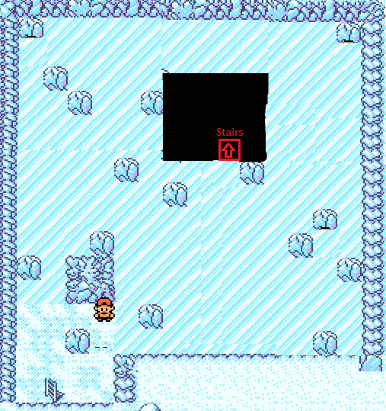
Game Description
a. Overview
In Slippery Lands, players embark on a winter journey, navigating through icy landscapes filled with puzzles, challenges, and hidden caverns. The game's big picture involves exploring a frozen world, solving puzzles, and finish the level in the least amount of slides. The central gameplay mechanic involves sliding on ice, moving crates to switches to open new doors and paths, find a way to get the crows out of your way, adding a unique twist to traditional puzzle-adventure games. There's also room for power ups, as you might find the elusive snow boots or the winter star as they might help to get a better grip wink navigating the levels. It's a puzzle centric game, the score is measured on the least amount of slides it took to finish the level.
b. The Quest
Help Ron get home! the main quest involves solving maze-like puzzles, strategically sliding on ice to reach key areas, avoiding obstacles, and uncovering hidden passages. The game is divided into levels, each presenting new challenges and mechanics. Players must carefully plan movements to avoid falling through cracked ice tiles, using broken paths to access new areas and reveal the secrets hidden beneath the frozen surface.

Slide 4
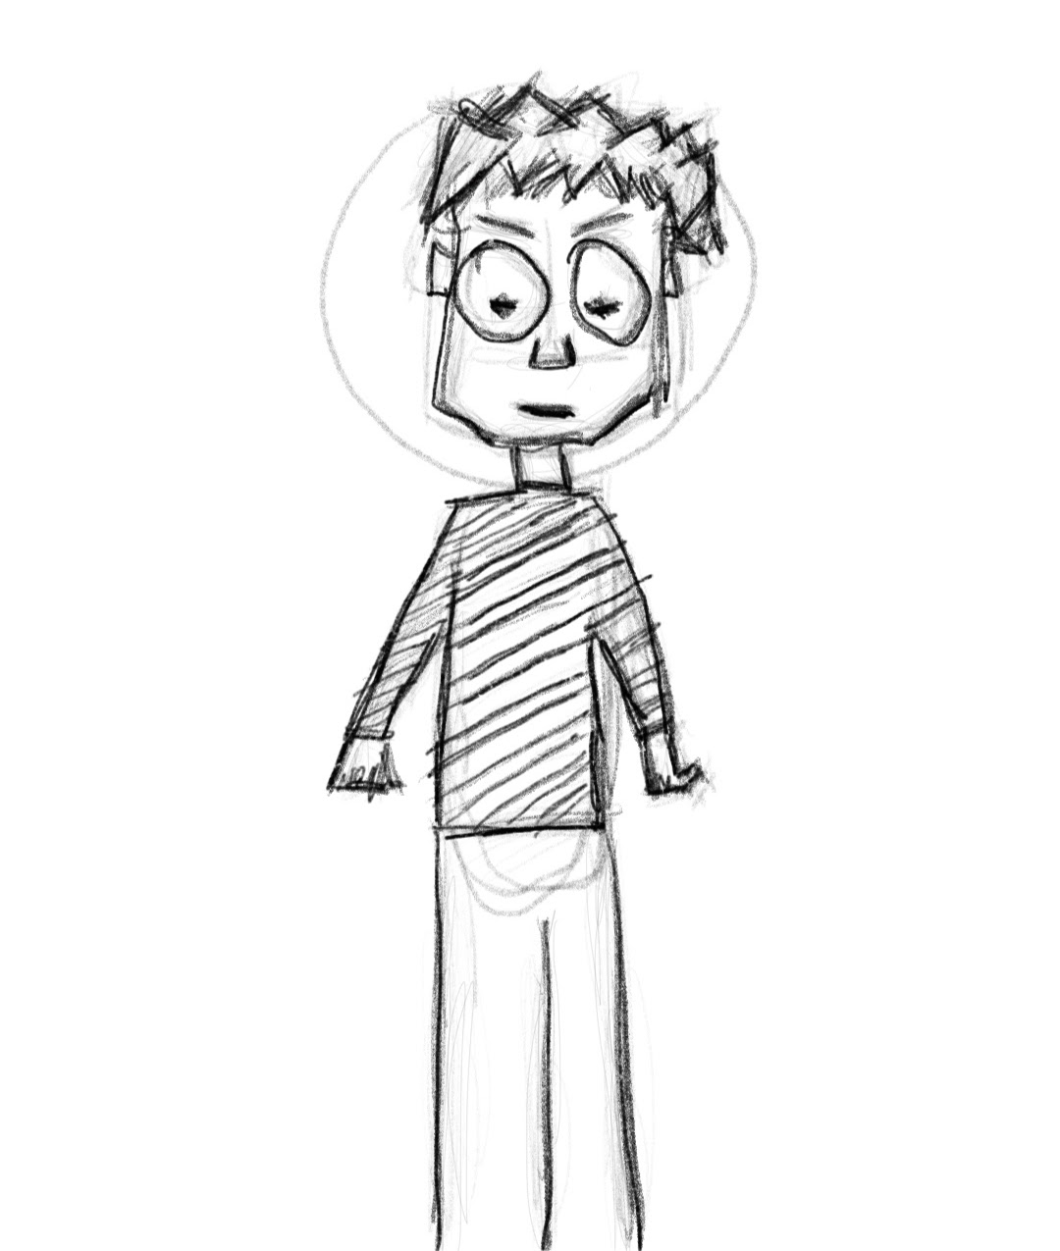

Game Description
c. Main Character
The main character is Ron, he's not sporty or the best explorer but has the wit and brains to get out of any situation, no matter how dangerous, has the ability to slide on ice strategically. Ron's abilities evolve with gameplay progression, gaining access to new skills and tools.
d. Sketch of Main Character

Slide 5
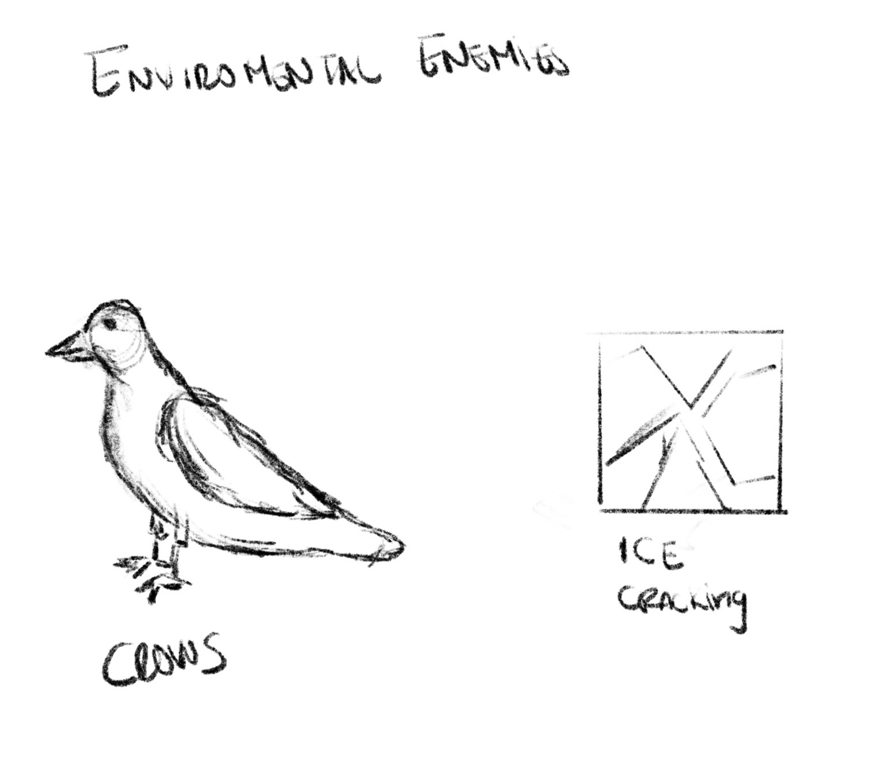

Game Description
e. Opponents
Opponents in Slippery Lands are mostly environmental entities, crows, ice cracking, fog. Their presence imposes a challenge to the player in order to finish the level. As our hero cannot directly attack, overcoming opponents requires a combination of strategy and brains, adding an extra layer of challenge to the game.
f. Sketch of Opponents

Slide 6
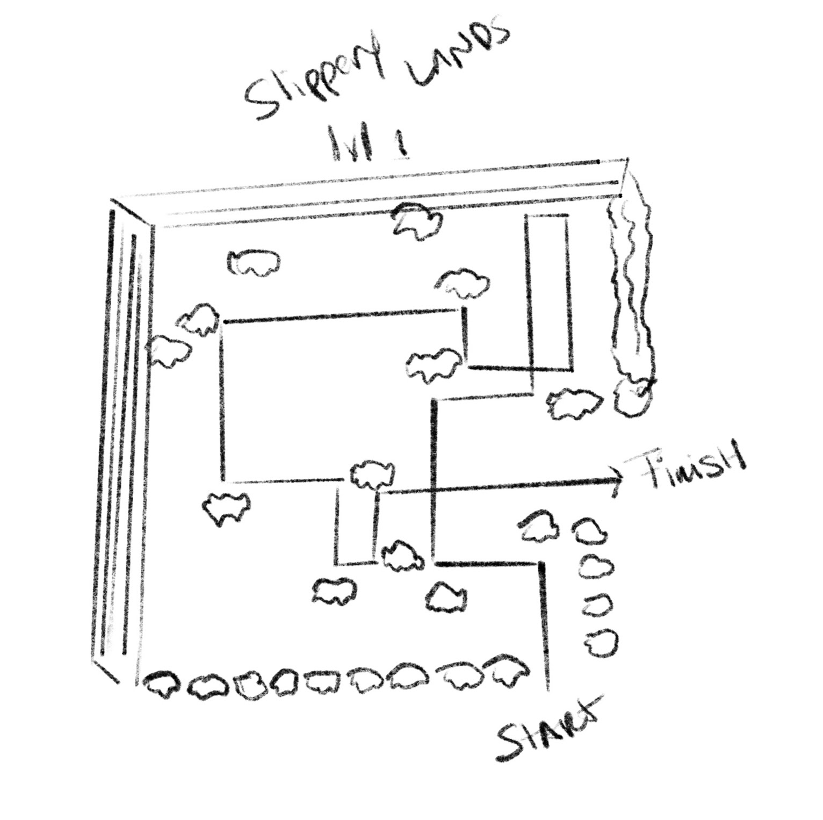
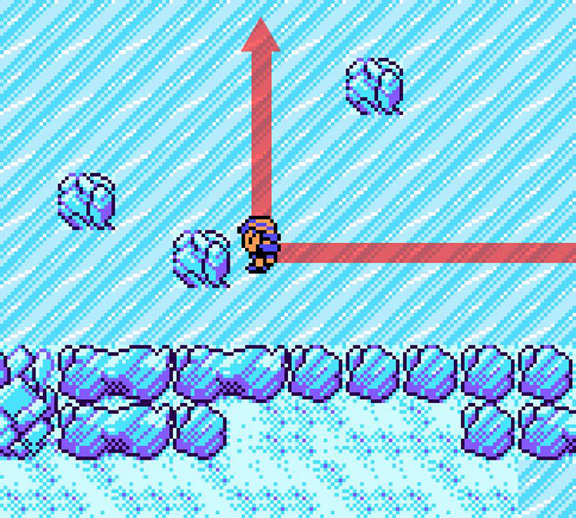
Game Description
Environment
The game is set in a visually icy landscape with intricate designs and hidden caverns. The environment is dynamic, featuring slippery ice tiles, cracked ice sections, and other interactive elements (like switches and crates).
h. Sketch of World

Slide 7
Game Description
i. Menus
The initial menu has a winter theme. Options include start game, Scores, and exit. The menu design is user-friendly, enhancing the overall gaming experience.
j. Controls
Players navigate through the game using intuitive controls, including arrow keys ↑→↓← or WASD. Additional commands include actions such as sliding, interacting with objects, and utilizing special abilities.
k. Sounds
The background sounds in Slippery Lands include ambient winter music, footsteps crunching on snow, and the occasional creaking of ice. These sounds create a moody atmosphere, enhancing the overall gaming experience.

Slide 8
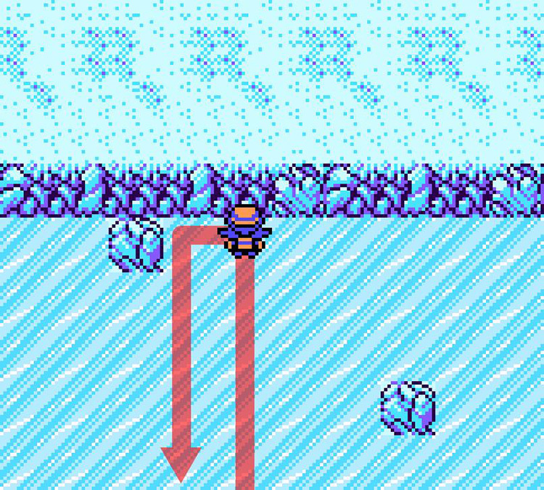
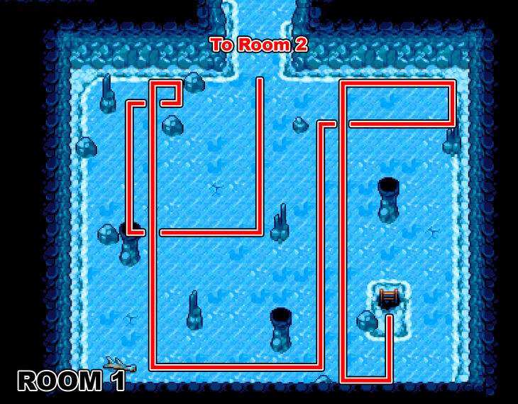
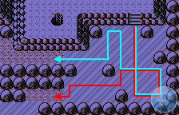
Summary
Slippery Lands offers a unique blend of puzzle-solving, adventure, and strategic thinking set in a visually stunning icy world. With its innovative sliding mechanic, dynamic environments, and progressively challenging levels, Slippery Lands promises an engaging and unforgettable gaming experience. Immerse yourself in the frozen mysteries and embark on a winter journey like no other. Slippery Lands - where every slide reveals a new adventure!

